Slide 1
AI ASSIGNMENT 2
CS22B035- LUKALAPU S V S RAGHURAM
CS22B045- S VINEETH RAGHAVENDRA

Slide 2
TSP Hill Climbing Algorithm
Heuristic Function: Total Tour Distance:
The heuristic function used in the hill_climb algorithm is:
def total_distance(tour, cities):
dist = 0
for i in range(len(tour)):
dist += np.linalg.norm(cities[tour[i]] - cities[tour[(i + 1) % len(tour)]])
return dist
This calculates the total Euclidean distance of the current tour. The objective is to minimize this distance, which aligns perfectly with the TSP goal.

Slide 3
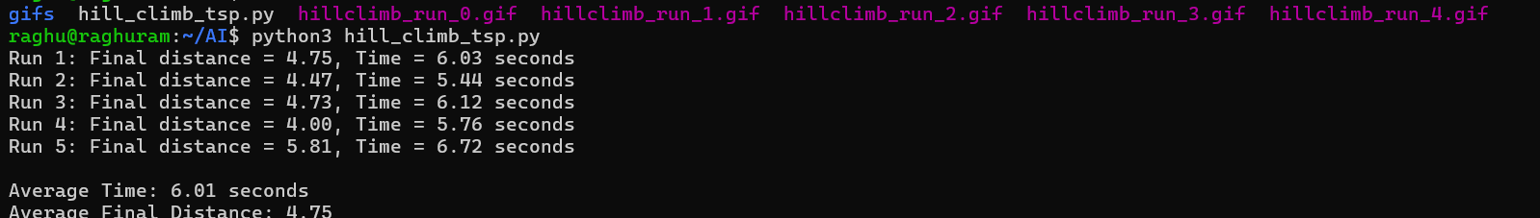

Slide 4
Analysis & Observations:
The best tour found was in Run 4 with a distance of 4.00, while the worst was 5.81 in Run 5.
Hill Climbing tends to get stuck in local minima, especially for complex landscapes like TSP. You can see this variance in final distances.
Execution time was fairly consistent (5.4–6.7s), mostly dependent on system speed and minor randomness

Slide 5
TSP SA
Greedy Heuristic (Nearest Neighbor Estimate)
def heuristic_estimate(current_city, unvisited, locations):
total = 0
current = current_city
unvisited_set = unvisited.copy()
while unvisited_set:
# Find the nearest unvisited city
nearest = min(unvisited_set, key=lambda city: np.linalg.norm(locations[current] - locations[city]))
total += np.linalg.norm(locations[current] - locations[nearest])
current = nearest
unvisited_set.remove(nearest)
# Return to start
total += np.linalg.norm(locations[current] - locations[current_city])
return total

Slide 6
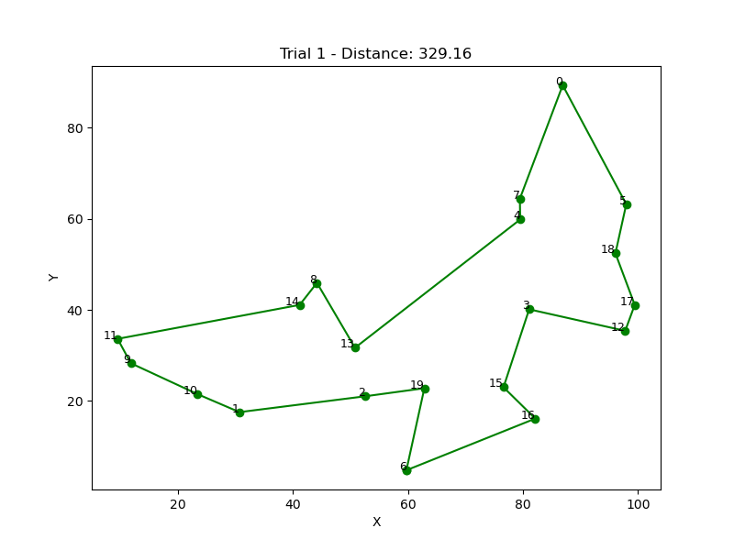
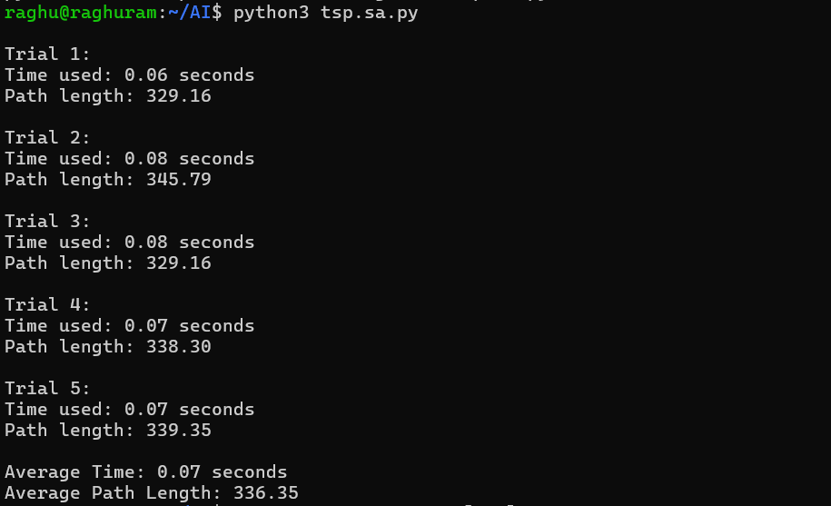

Slide 7
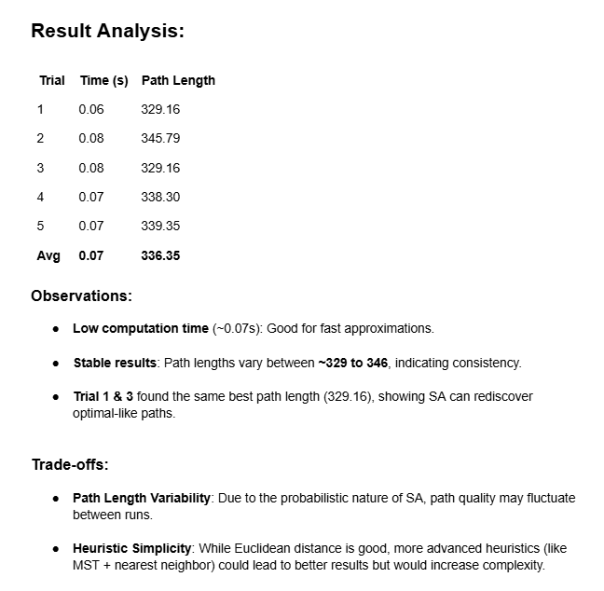

Slide 8
FRESH LAKE
1. Branch and Bound (BnB)
queue = deque([(start_state, [], 0)])
State representation: (current_state, path, depth)
Search method: Breadth-First Search (BFS) style
Bounding: You check visited nodes to avoid revisiting, but there’s no cost-based pruning (no actual "bound").
Heuristic: Not used
So, our "Branch and Bound" is actually an uninformed BFS—it does not use a cost function or heuristic to prune paths or explore better ones first.
2. Iterative Deepening A* (IDA*)
def dfs(state, path, depth, limit, visited):
State representation: (state, path, depth)
Limit: you use the depth as the cost, and increase the limit gradually.
Search method: Iterative Deepening Depth-First Search (IDDFS)
Heuristic: Not used, only depth
So, our IDA* is actually plain IDDFS, because there is no f(n) = g(n) + h(n) computation guiding the search.

Slide 9
Time Efficiency:
Branch and Bound is significantly faster (~0.00s vs 0.04s).
This is expected because your BnB is just BFS — it quickly finds the shortest path in this small grid.
No recursive overhead or depth-bound iteration.
IDA* is slower due to:
Recursive calls.
Iteratively deepening depth limit from 0 up to 6.
No heuristic to guide search — it's doing brute-force DFS up to depth limit.

Slide 10
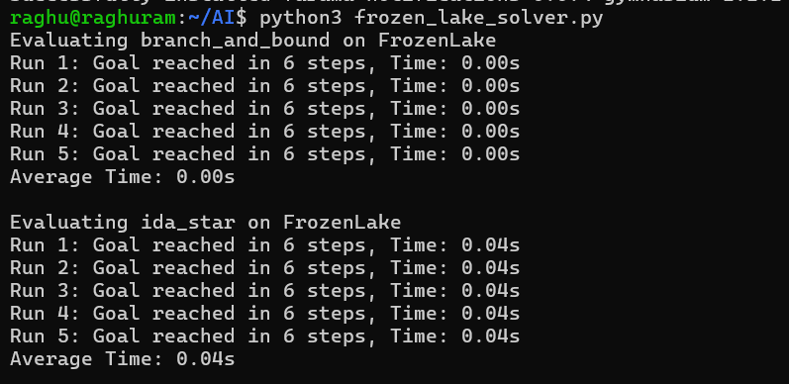

Slide 11
ANT MAZE SOLVER
1. Manhattan Distance :
def heuristic(a, b):
return abs(a[0] - b[0]) + abs(a[1] - b[1])
Best for: 4-direction movement (up, down, left, right) — exactly like your AntMaze.
Admissible and consistent → optimal path guaranteed with IDA*.
No need to change unless you want to try others.

Slide 12
